Slide 1
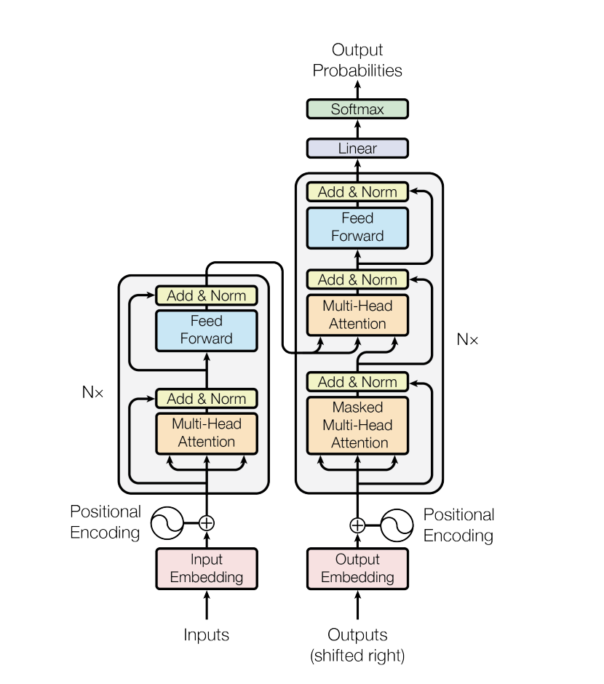
Attention
Translation Task
6 encoder layers and 6 decoder layers
512 dim, 8 heads
https://arxiv.org/pdf/1706.03762

Slide 2
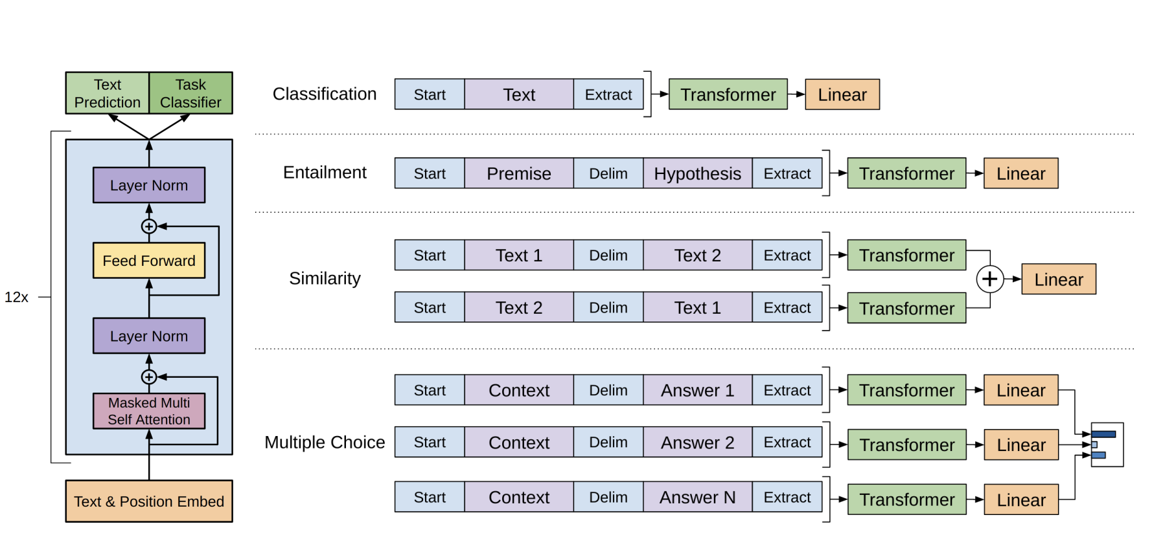
GPT-1
The original decoder transformer
12 layers, 768 dim, 12 heads
Pre-training on 7000 unpublished books with unsupervised learning
Fine-tuning with labelled data by introducing extra parameters for different tasks
https://cdn.openai.com/research-covers/language-unsupervised/language_understanding_paper.pdf

Slide 3
GPT-2
Reuse the GPT-1 model
1.5 B parameters, changes: layer norm before attention/MLP, additional layer norm after final attention
50256 vocabulary size
Trained on WebText, 40 GB
Increased context size from 512 to 1024, a batchsize of 512
Prove language model can perform tasks in zero-shot setting
https://cdn.openai.com/better-language-models/language_models_are_unsupervised_multitask_learners.pdf

Slide 4
GPT-3
Reuse the GPT-2 model, 175 B parameters
Increased context size from 1024 to 2048
No fine-tuning step
https://arxiv.org/pdf/2005.14165

Slide 5
Llama 1
Based on the transformer decoder, 10x smaller than GPT-3
Use pre-norm, RMSNorm
SwiFLU activation
Rotary Embedding
Finetuning on instructions data (SFT)
Improved performance
Follow instructions
https://arxiv.org/abs/2302.13971

Slide 6
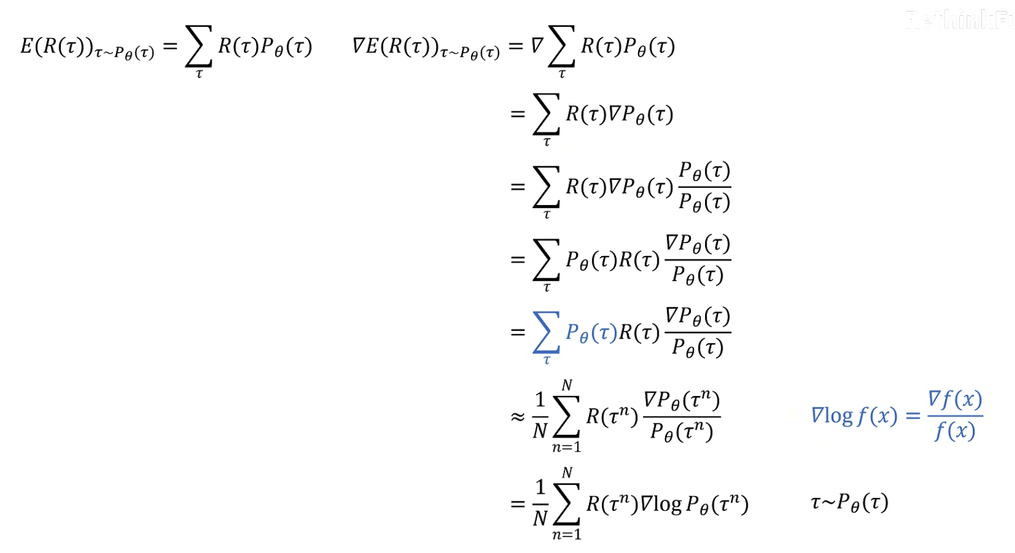
PPO

Slide 7
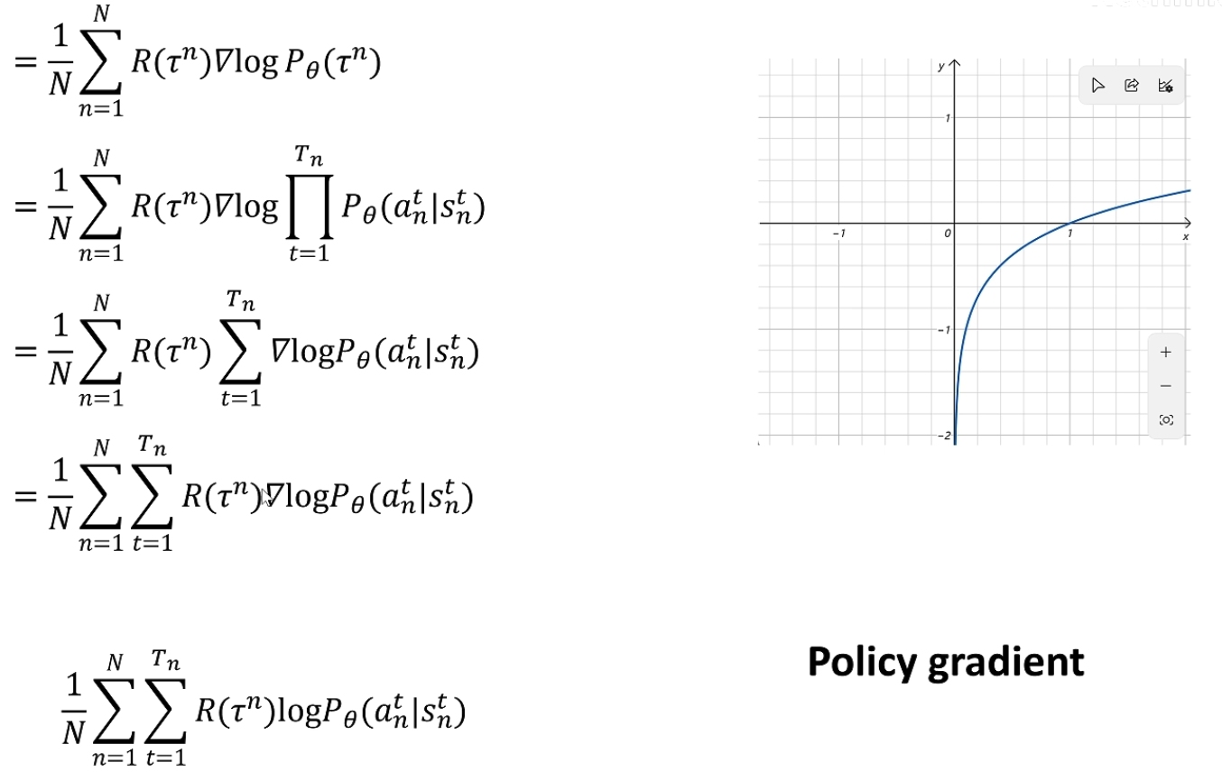
PPO

Slide 8
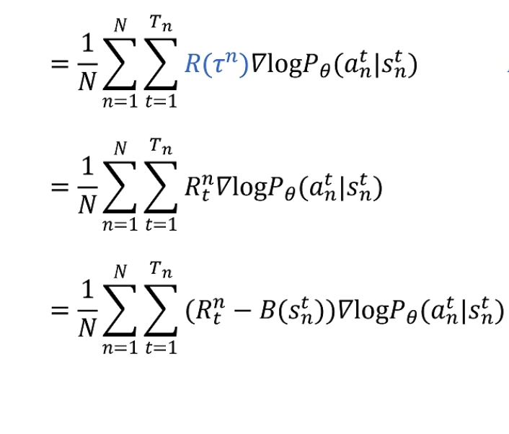
PPO

Slide 9
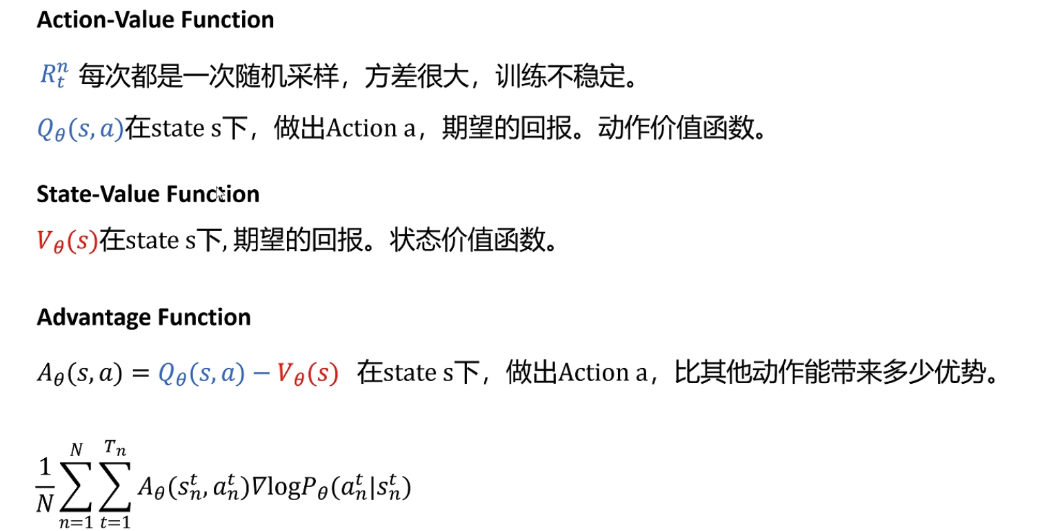
PPO

Slide 10
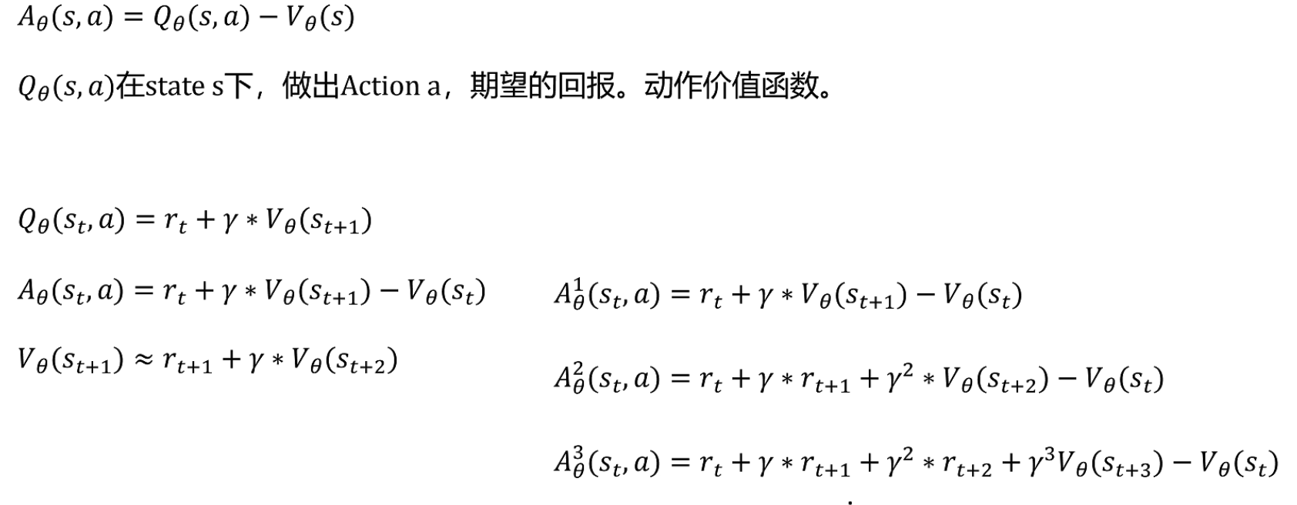
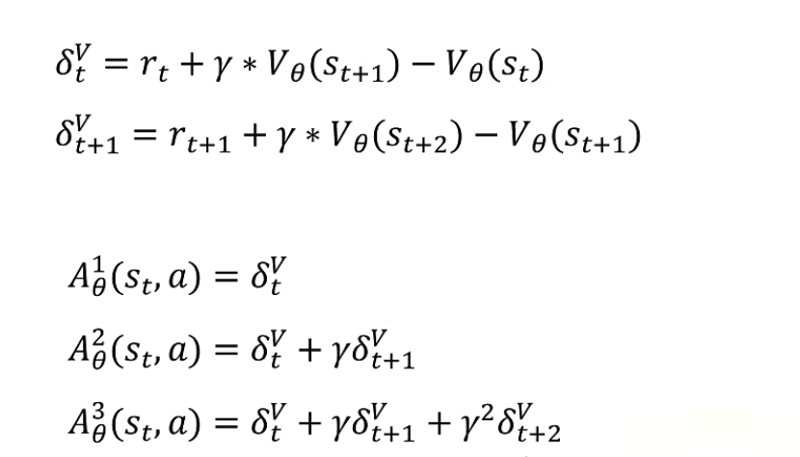
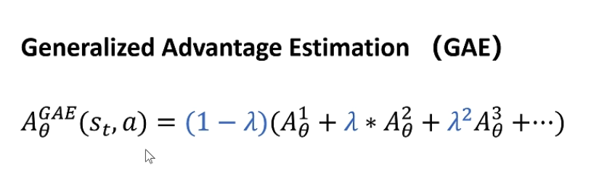
PPO

Slide 11
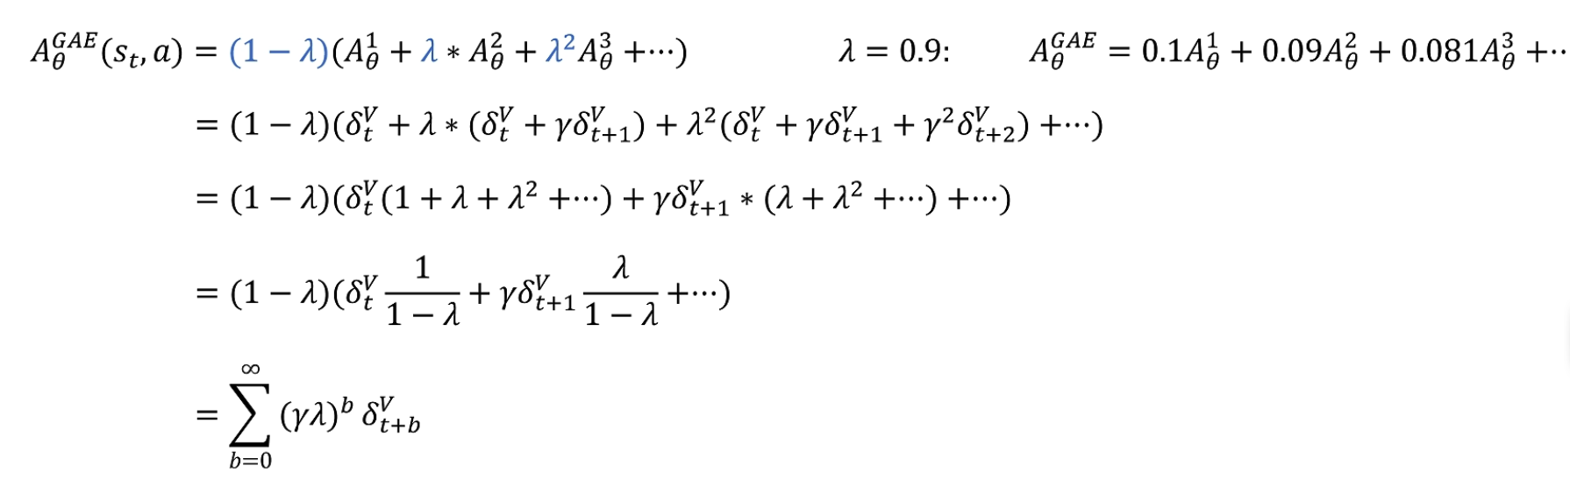
PPO

Slide 12
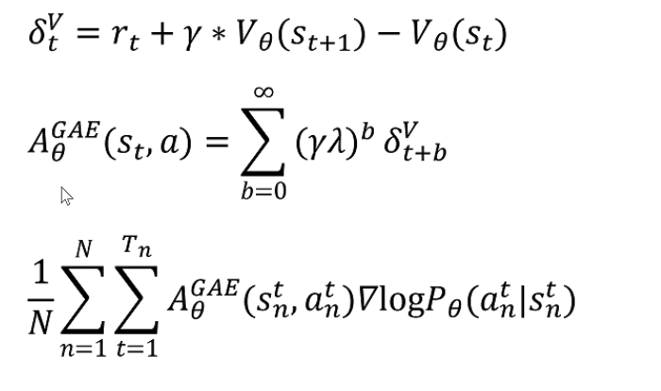
PPO

Slide 13
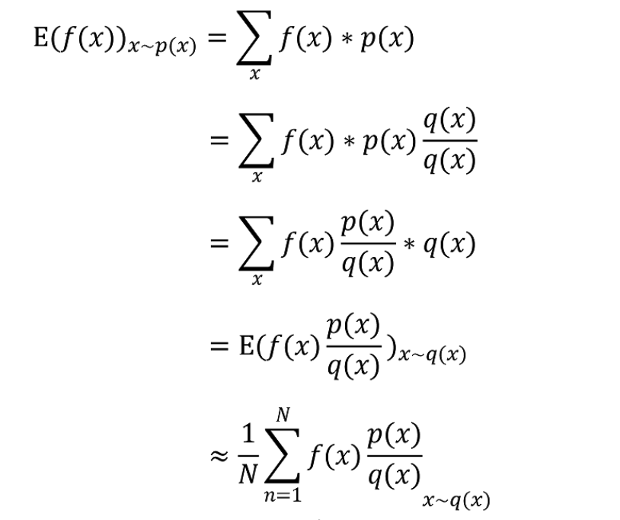
PPO

Slide 14
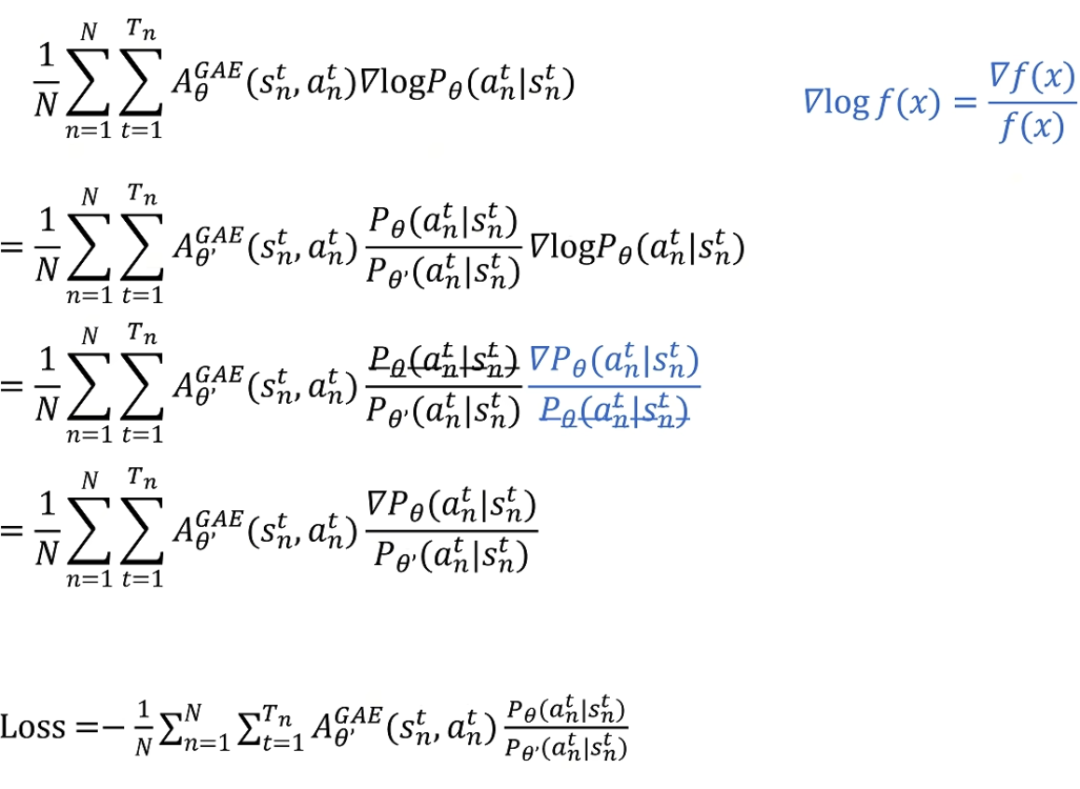
PPO

Slide 15
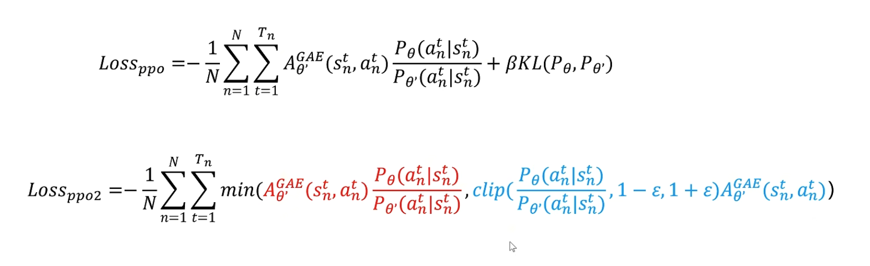
PPO

Slide 16
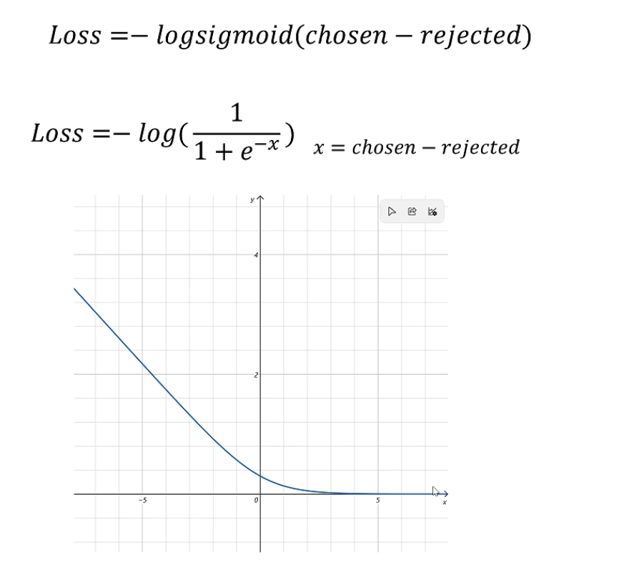
PPO

Slide 17
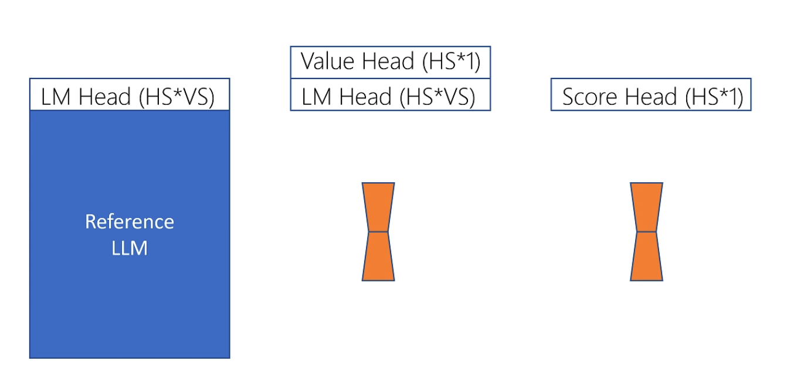
PPO

Slide 18
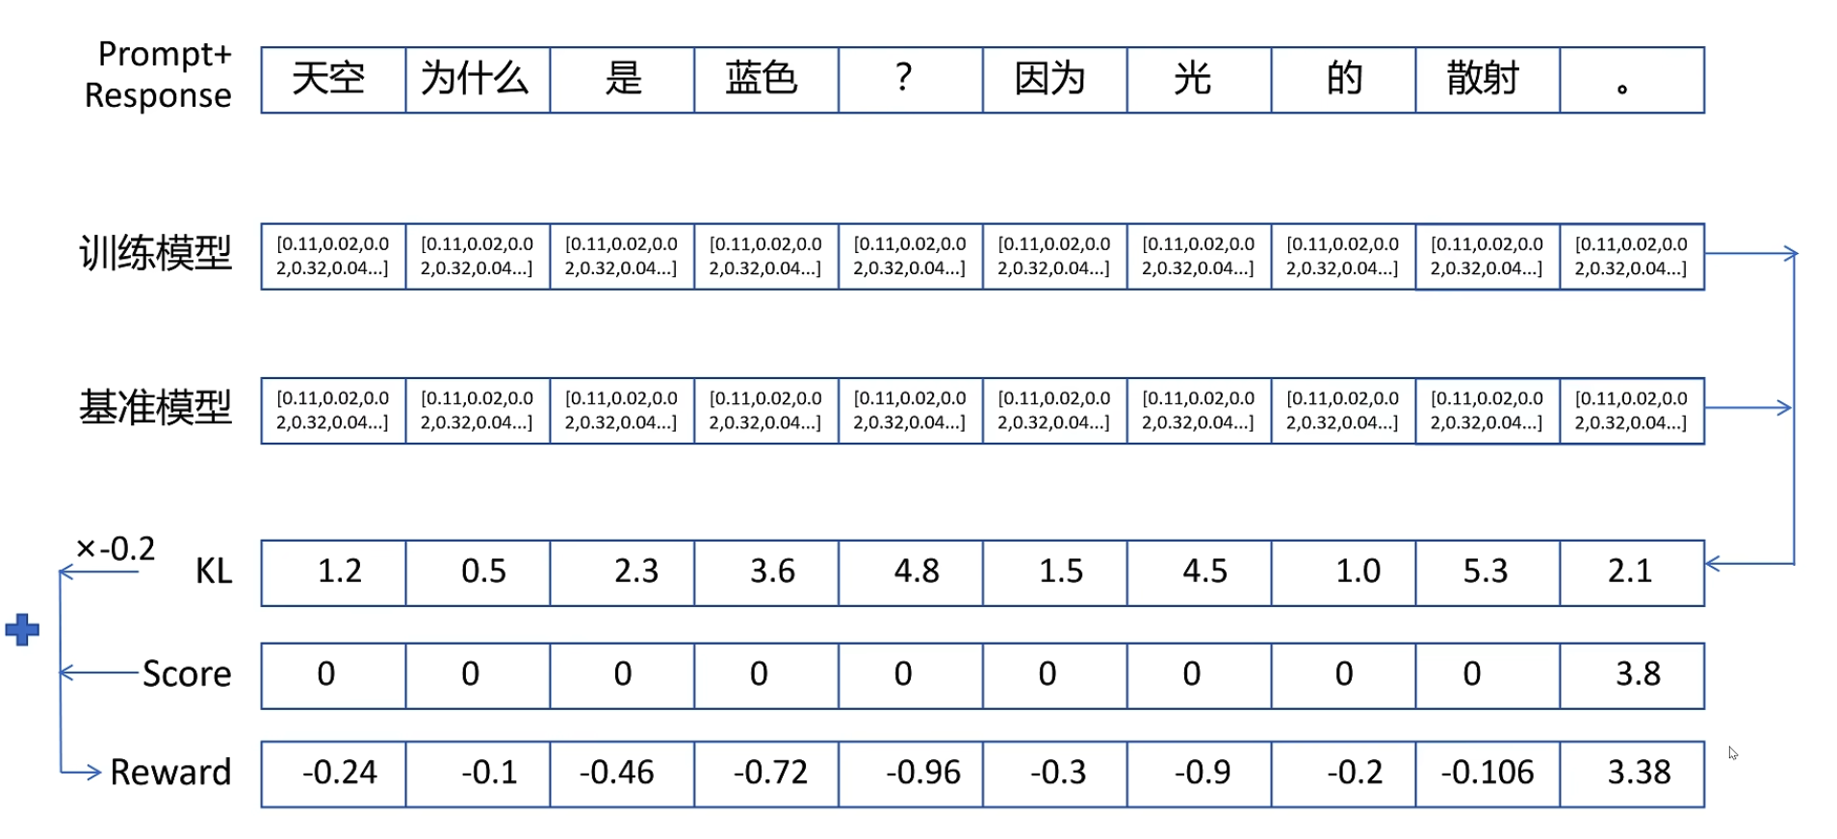
PPO

Slide 19
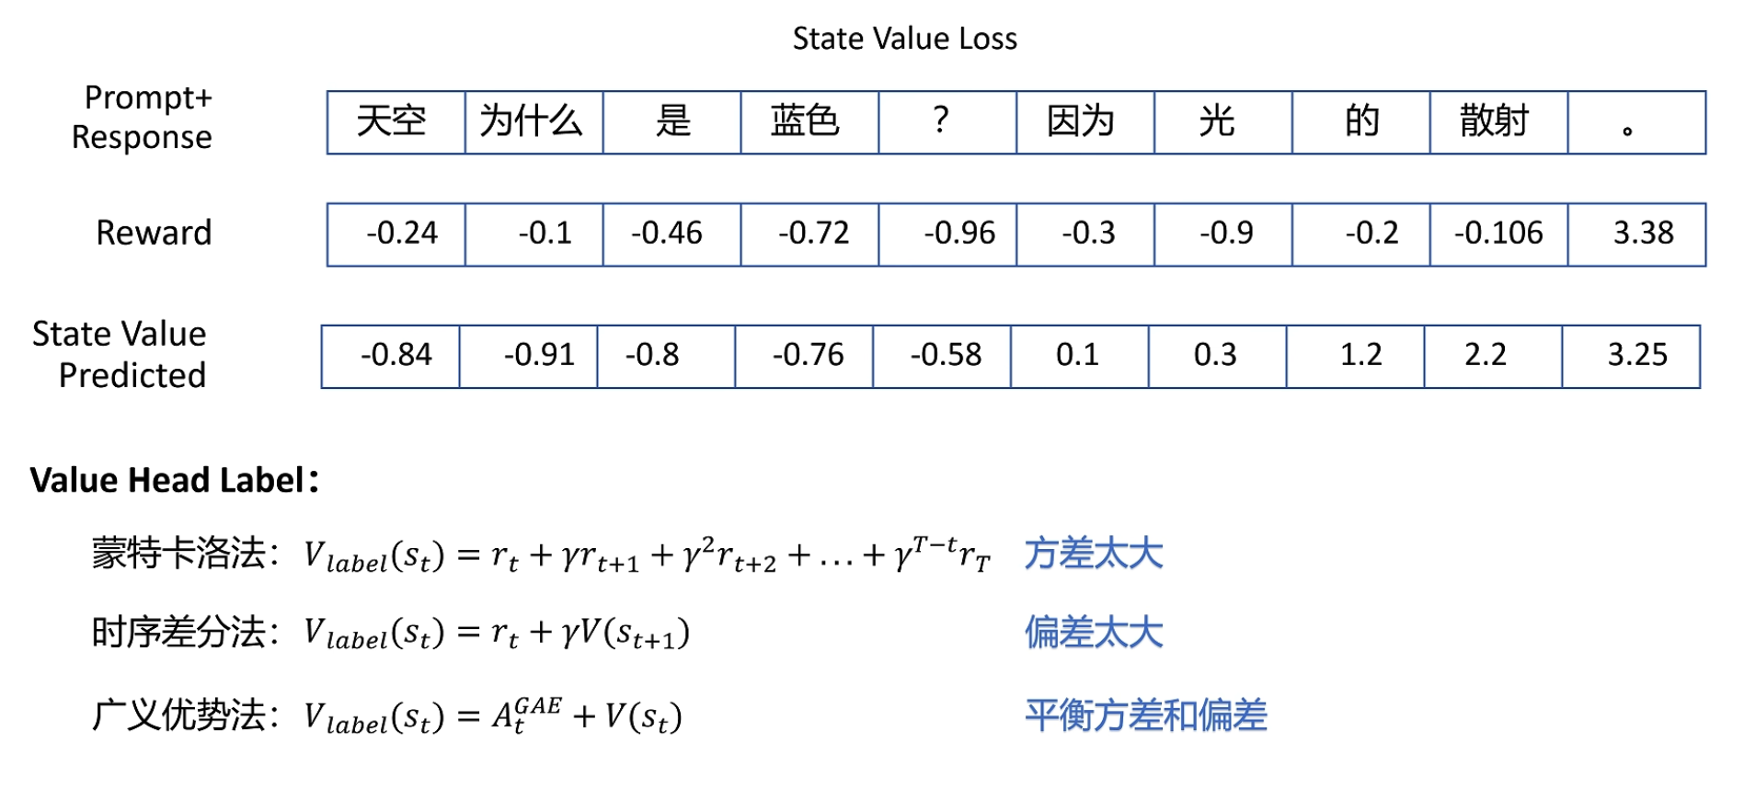
PPO

Slide 20
Llama 2
Based on the Llama-1, increased context length, used Group Query Attention (GQA)
Instruction tuning and reinforcement learning from human feedback (RLHF)
RLHF: to align model behavior with human preferences and instruction following
Proximal Policy Optimization + Rejection Sampling fine-tuning
Safety SFT
https://arxiv.org/pdf/2307.09288

Slide 21
Direct Preference Optimization (DPO)
Significantly reduce computational loss
Optimize the same objective as existing RLHF
https://arxiv.org/pdf/2305.18290

Slide 22
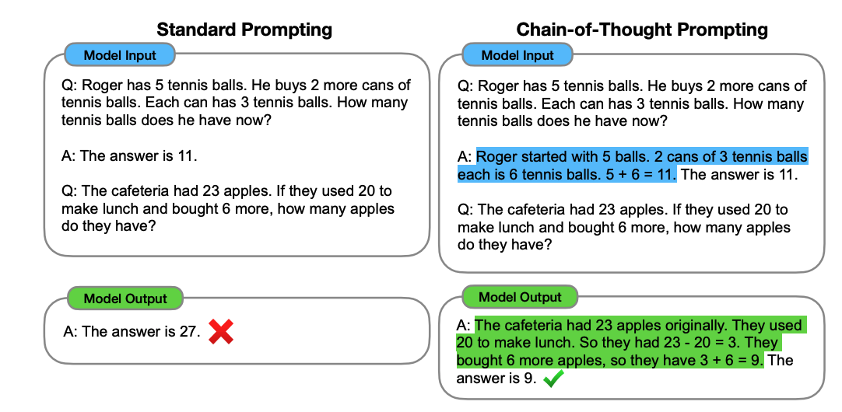
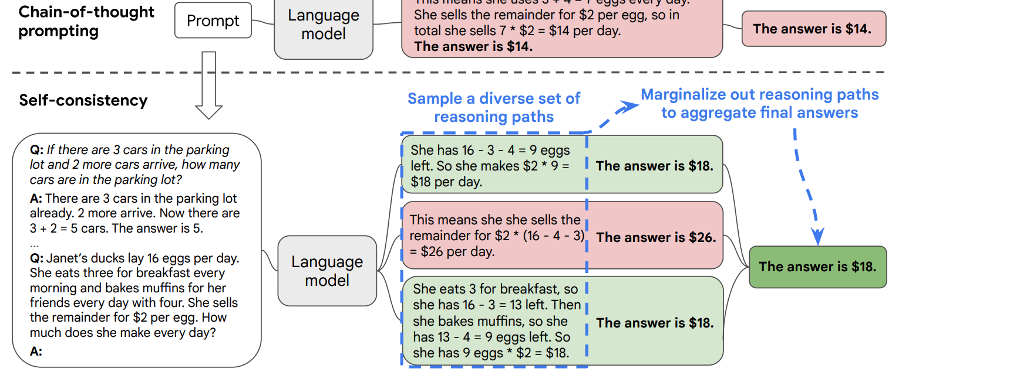
Reasoning
Chain-of-Thought Prompting Elicits Reasoning in Large Language Models: https://arxiv.org/pdf/2201.11903
Self-Consistency improves chain of thoughts reasoning in language model: https://arxiv.org/pdf/2203.11171
Tree of thoughts: https://arxiv.org/pdf/2305.10601
Graph of thoughts: https://arxiv.org/pdf/2305.16582

Slide 23
Reasoning
Zero-shot CoT: https://arxiv.org/pdf/2205.11916
The Impact of Reasoning Step Length on Large Language Models: https://arxiv.org/pdf/2401.04925 (test-time scaling)
Supervised Fine-Tuning on reasoning datasets
Human labelers
Prompt models and obtain CoTs
Reinforcement learning
Outcome reward model: https://arxiv.org/pdf/2401.08967
Process reward modeL:
https://arxiv.org/pdf/2312.08935

Slide 24
Reasoning
Reasoning survey: https://arxiv.org/pdf/2501.09686

Slide 25
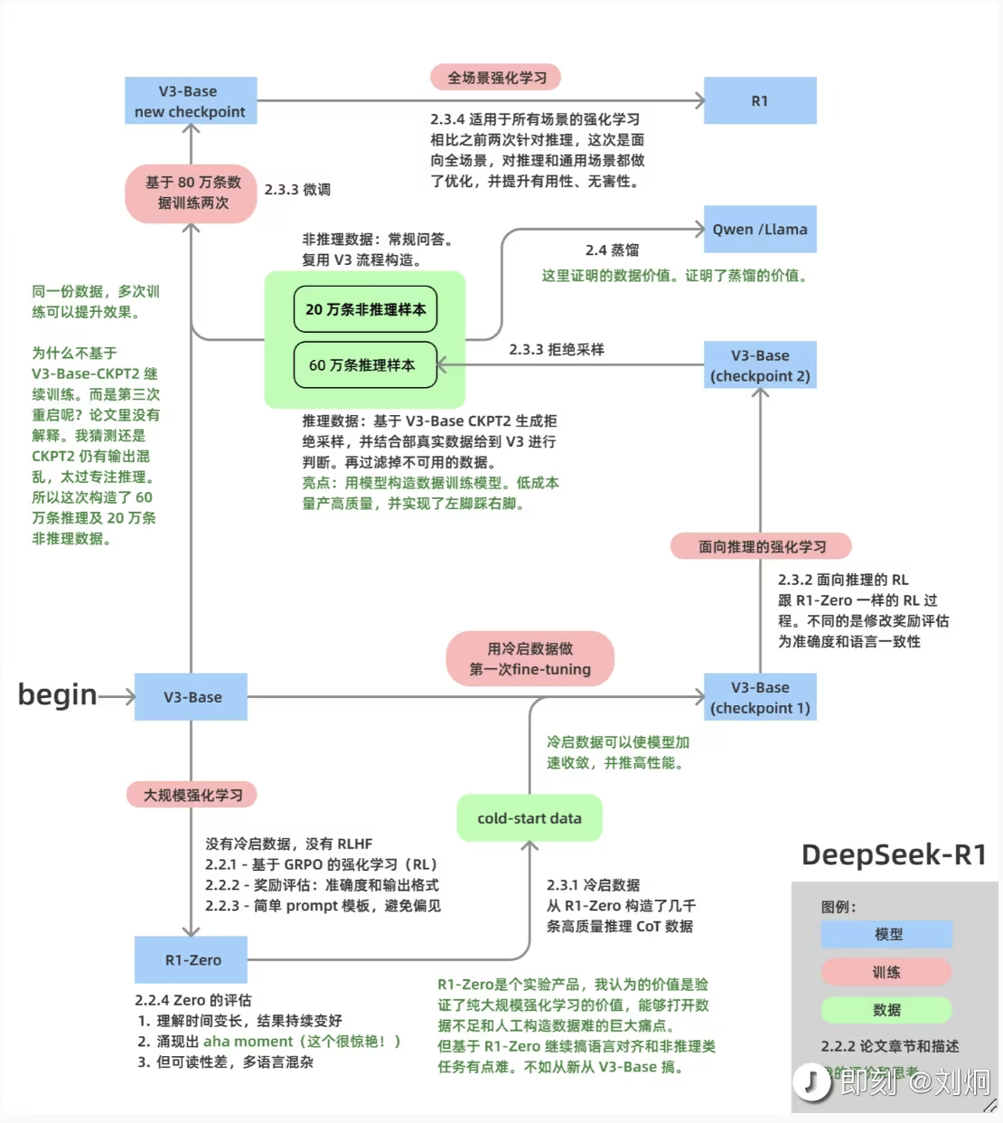
DeepSeek
https://arxiv.org/pdf/2501.12948

Slide 26
s1: Simple test-time scaling
https://arxiv.org/pdf/2501.19393v2
Generate CoT data
Filter data
Test-time scaling: 1. Sequential 2. Parallel
Force quit by adding end-of-thinking token delimiter and “Final Answer:”
Suppress the generation of the end-of-thinking token delimiter and optionally add “Wait”

Slide 27
Acknowledge
The PPO algorithm is from RethinkFun: https://www.bilibili.com/video/BV1iz421h7gb/?spm_id_from=333.1391.0.0&vd_source=f7c8e7404cd8c3c7e3fc7b5bf8ad8740
DeepSeek illustration is from Jiong Liu

